Slide 1

WELCOME
TO OUR PRESENTATION

Slide 2

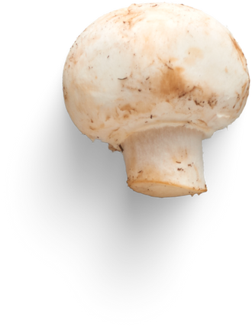
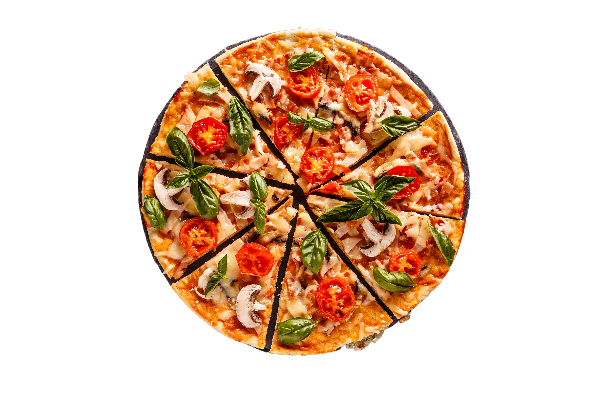



PIZZA
Sales Performance Analysis
A.ABHILASH REDDY

Slide 3

OBJECTIVE
Analyze transactional pizza sales data from a PIZZA shop using SQL to identify product trends, revenue drivers, and time-based patterns. helping the business improve offerings, pricing, and operations.

Slide 4
DATASET OVERVIEW
DATASETS USED IN THIS ANALYSIS
ORDER_DETAILS
Order_details_id
Order_id
Pizza_id
Quantity
ORDERS
Order_id
Order_date
Order_time
PIZZAS
Pizza_id
Pizza_type_id
Size
Price
PIZZA_TYPES
Pizza_type_id
Name
Category
Ingredients

Slide 5
AREAS OF ANALYSIS
SALES PERFORMANCE
REVENUE INSIGHTS
Total Orders
Total Quantity Sold
Total Revenue
Highest & Lowest Pizza Price
Highest Order Value
Average Revenue per Order
Average Order Value by Category
Revenue % Contribution by Category
PRODUCT LEVEL ANALYSIS
TIME BASED ANALYSIS
Pizza sales by category
Size-wise sales
Most selling pizzas per month
Top pizzas by category
pizza type performance
Monthly Sales & Growth Rate
Highest/Lowest Revenue Month
Day-wise Sales Patterns
Time Slot Analysis (hour-wise)

Slide 6

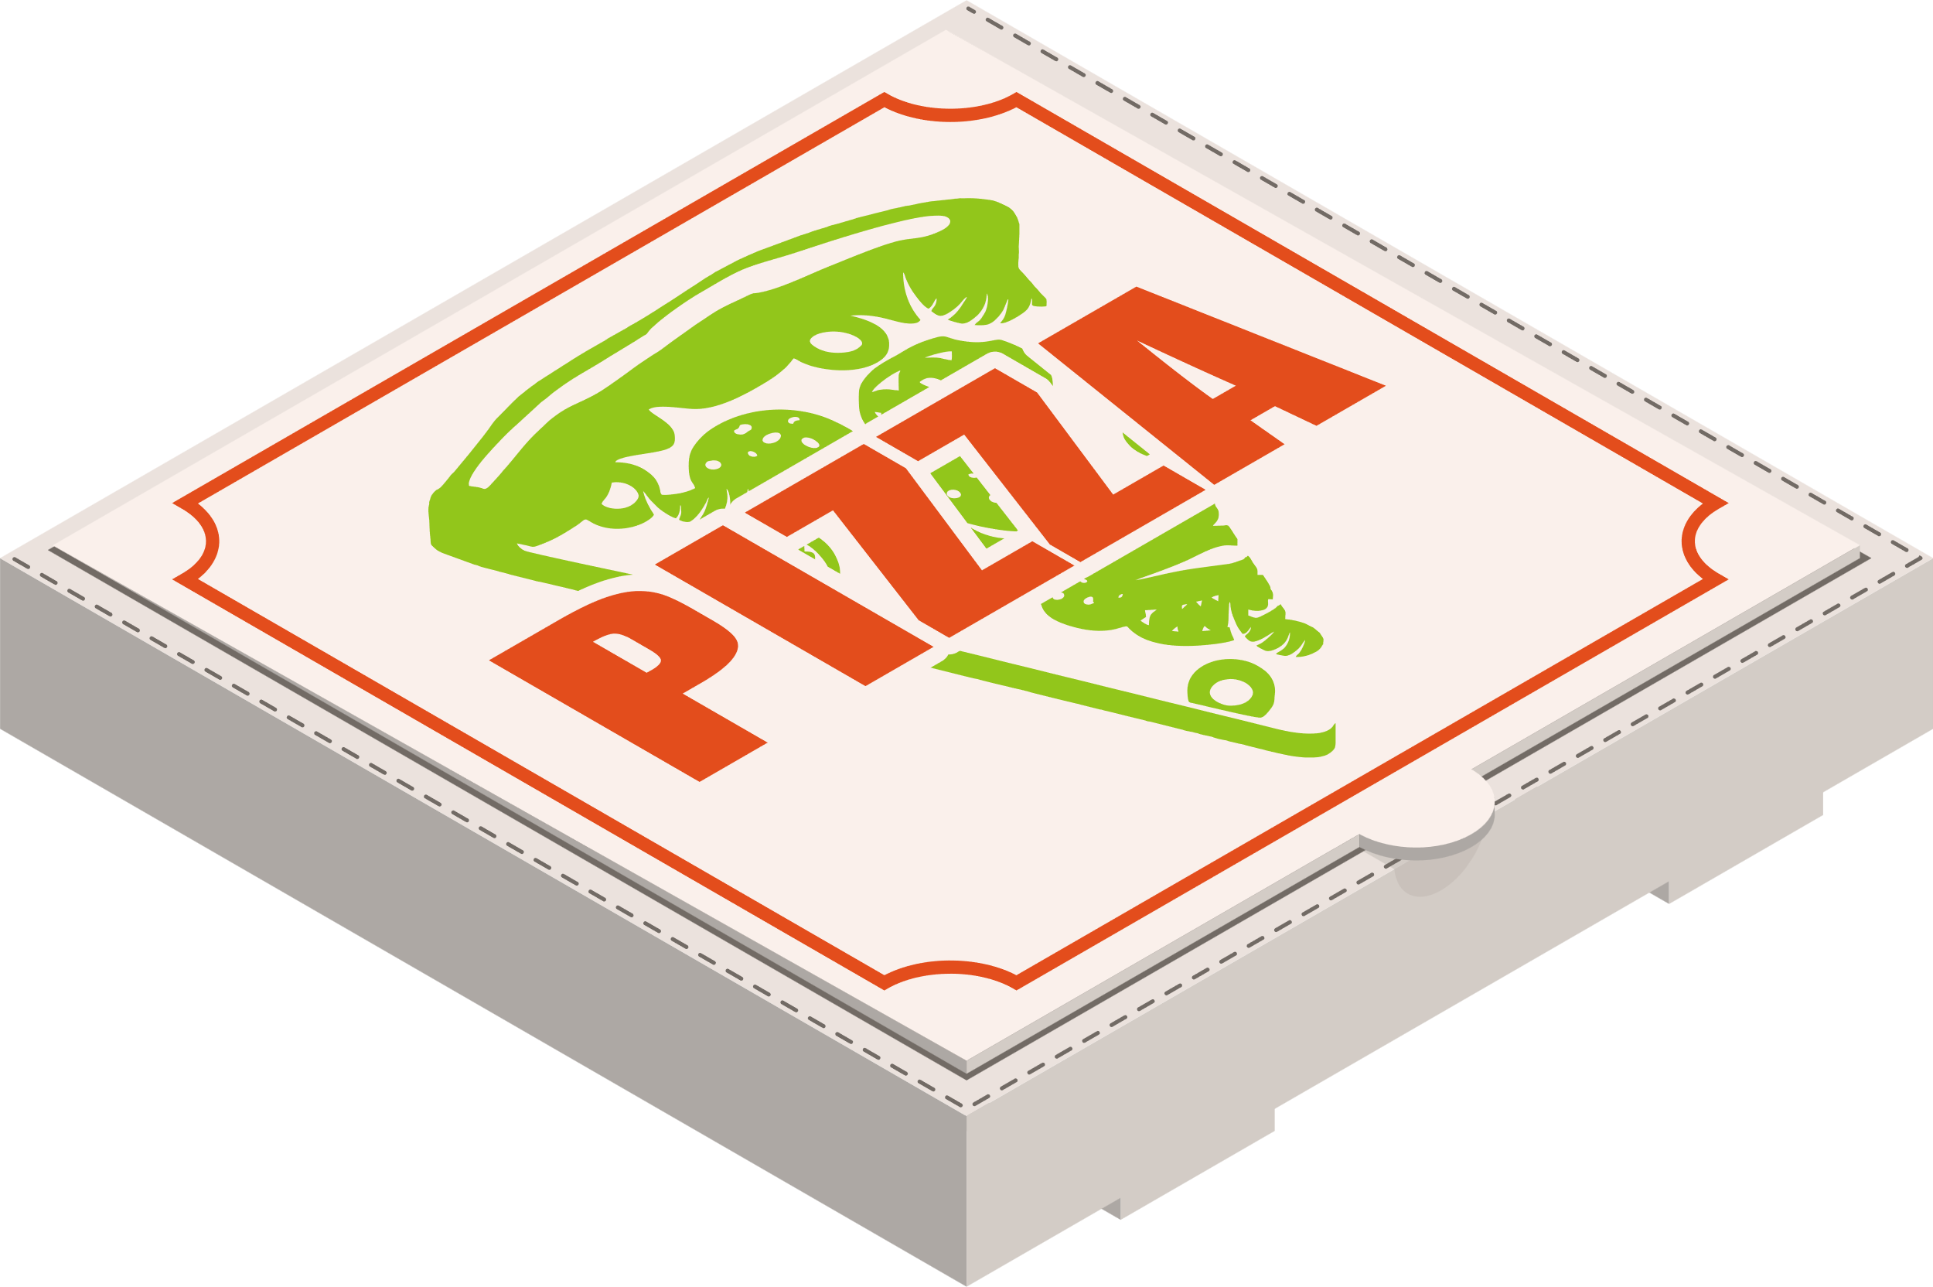







KEY KPIS
TOTAL ORDERS
TOTAL PIZZAS SOLD
TOTAL REVENUE
21350
49574
₹20.45 M
AVERAGE REVENUE PER ORDER
LEAST ORDER VALUE
₹957.68
₹243.75
HIGHEST ORDER VALUE
HIGHEST PIZZA PRICE
LEAST PIZZA PRICE
₹11105
₹898.75
₹243.75

Slide 7

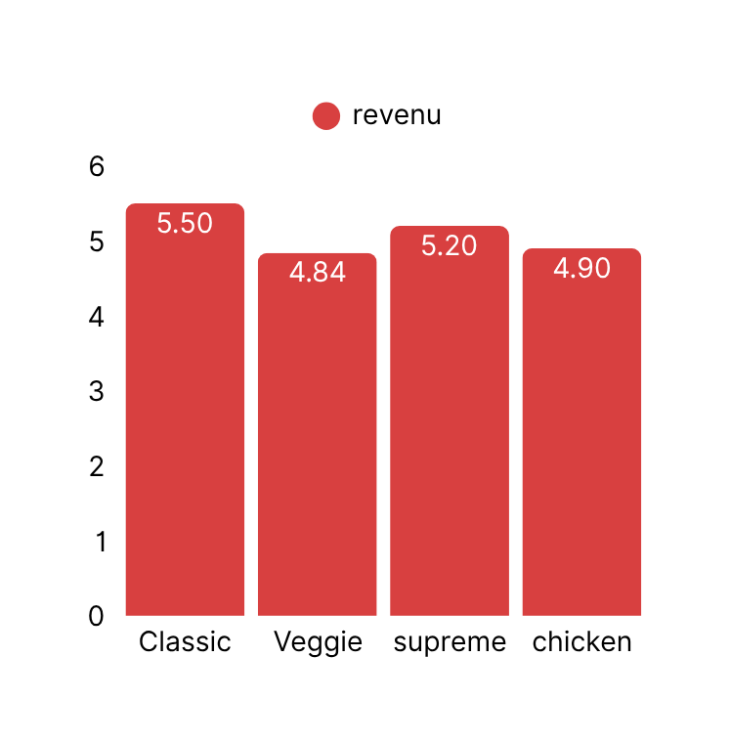
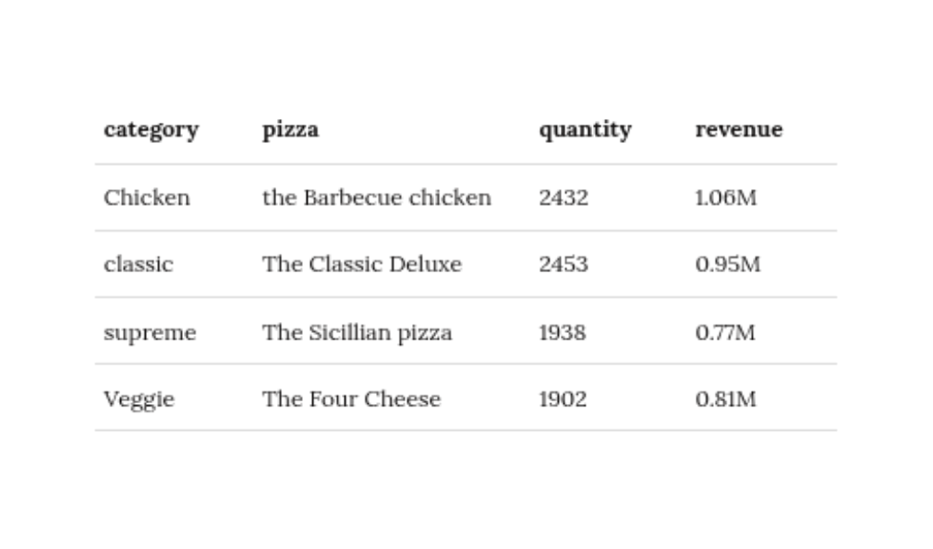
CATEGORY ANALYSIS
THE PIZZA SHOP OFFERS FOUR CATEGORIES
CATEGORY WISE REVENUE ANALYSIS
CLASSIC
VEGGIE
CHICKENE
SUPREME
BEST SELLING PIZZA BY CATEGORY
CLASSIC CATEGORY GENERATED THE HIGHEST REVENUE AND QUANTITY SOLD
* REVENUE VALUES IN RUPEES ₹

Slide 8
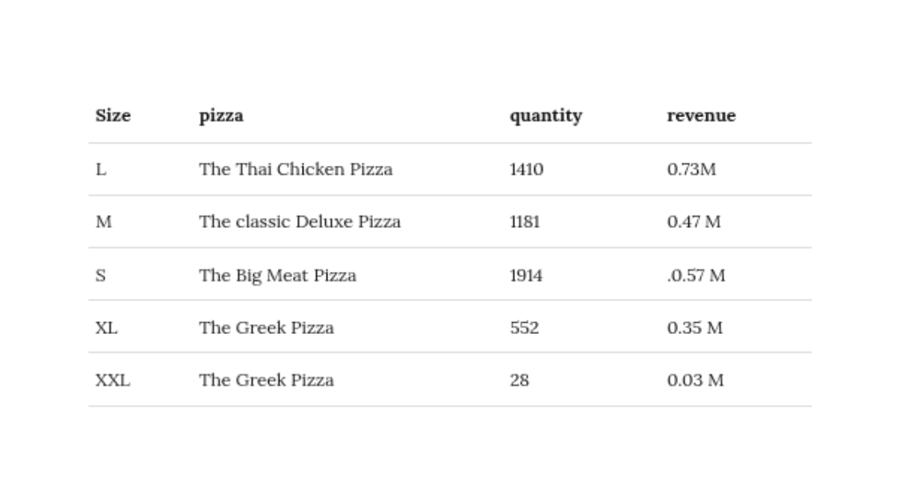
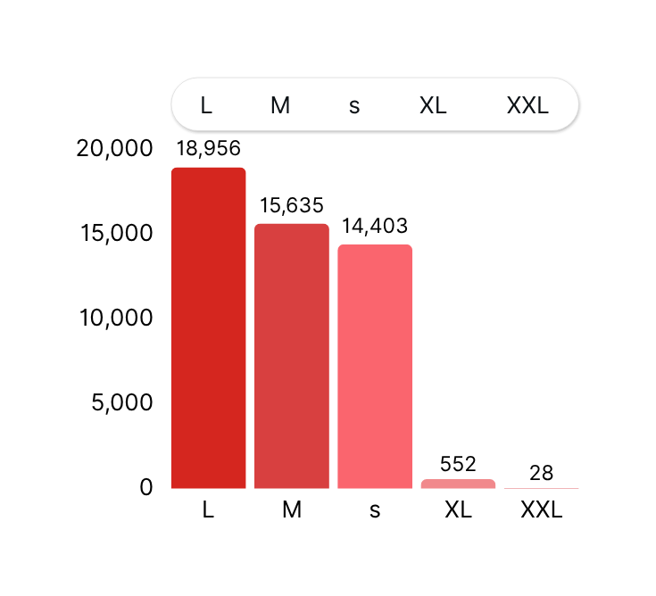
SIZE ANALYSIS
THE PIZZA SHOP OFFERS PIZZAS IN 5 SIZES
SIZE WISE REVENUE ANALYSIS
S
M
L
XL
XXL
BEST-SELLING PIZZA BY SIZES
'S' SIZE SELLS THE MOST IN QUANTITY, WHILE 'L' SIZE GENERATES THE HIGHEST REVENUE.
'" REVENUE IN RUPEES

Slide 9
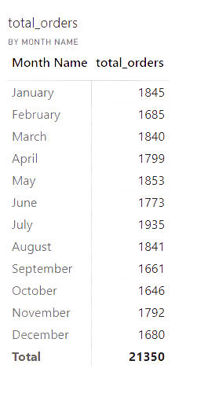
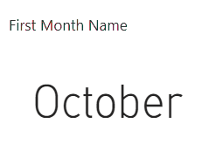
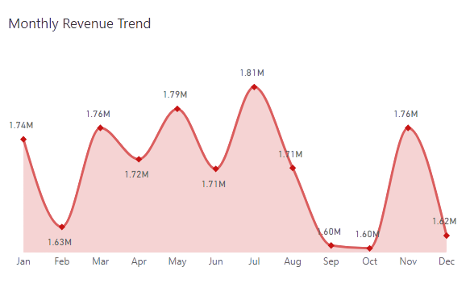
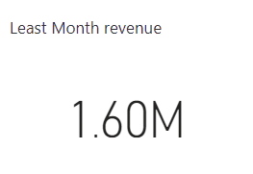
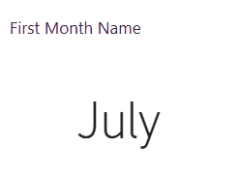
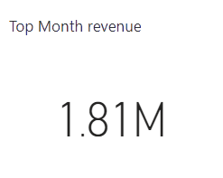
MONTHLY ANALYSIS
MONTHLY ORDERS
LEAST REVENUE MONTH
MONTHLY REVENUE TREND
HIGHEST REVENUE MONTH
** REVENUE IN RUPEES ₹

Slide 10
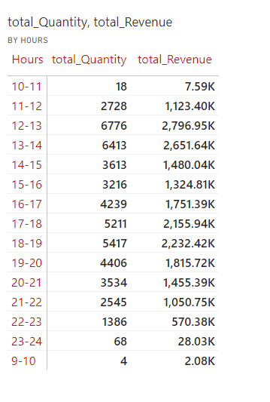
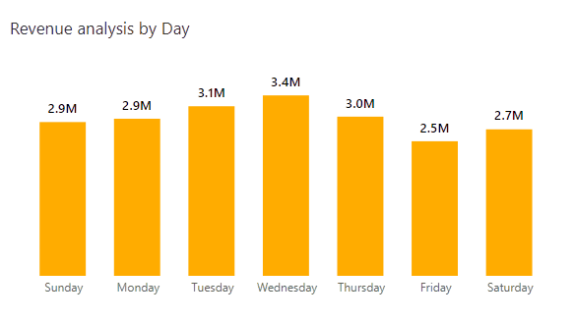
DAY & TIME ANALYSIS
HOURLY ANALYSIS
DAY REVENUE ANALYSIS
** REVENUE IN RUPEES ₹

Slide 11
KEY BUSINESS INSIGHTS
🍕 Top Performing Products:
Highest quantity sold: The Classic Deluxe Pizza – 2,432 units
Highest revenue: The Thai Chicken Pizza – ₹1.09M
📦 Overall Performance:
Total revenue: ₹9.38M
Total quantity sold:18,956 pizzas
Best-selling size (revenue): Large ("L")
📆 Sales by Day:
Highest revenue day: Wednesday
Lowest revenue day: Friday
⏰ Sales by Time:
Busiest hour: 12 PM – 1 PM
Least busy hour: 9 AM – 10 AM
🍕 Category Performance:
Highest revenue category: Classic – ₹5.50M
Lowest revenue category: Veggie – ₹4.84M
🍕 Least Performing Pizza (Revenue & Quantity):
The Brie Carre Pizza
Quantity sold: 490 Revenue: ₹0.29M
📏 Lowest Performing Size:
Size: XXL
Quantity: 28
Revenue: ₹0.30M
** REVENUE IN RUPEES ₹

Slide 12


A.ABHILASH REDDY

